Slide 1

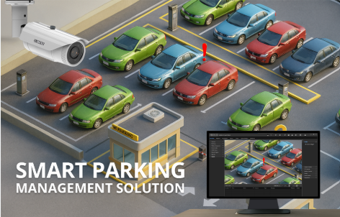
Design and Simulation
of a Smart Parking
Slot Availability
and Entry Control
System Using
Combinational logic
Presented By:
B. Aadhyaa • A. Rutajith Singh • MD. Mubashereen • Shaheena Amreen • A. Pooja

Slide 2


Introduction:
What is Smart Parking?
A smart parking system is a digital system that monitors the availability of parking spaces and controls whether a vehicle can enter the parking area. In a traditional parking system, drivers may have to search manually for an empty slot.
This can cause:
Time wastage
Traffic congestion
Difficulty in finding vacant spaces
Unnecessary fuel consumption
A smart parking system solves this problem by using sensors and digital logic to determine whether parking slots are available.

Slide 3

Objectives of the Project :
Determine the availability of parking space.
Control vehicle entry automatically.
Display the parking status.
Design the system using basic logic gates.
Simulate the circuit using Logisim.
Detect whether parking slots are occupied or vacant.
How does our system work?
Our proposed system takes information from parking-slot sensors as digital inputs. The system checks:
Which parking slots are occupied or empty.
Whether at least one slot is available.
Whether a vehicle should be allowed to enter.
Whether the parking area is full.
The decision is made using combinational logic circuits, so the output depends only on the current input conditions.

Slide 4

Simple Example:
Suppose there are 4 parking slots:
0 → Slot is empty
1 → Slot is occupied
If the inputs are: S1 S2 S3 S4 = 1 1 0 1
Slot 3 is empty, so the system detects that parking is available and allows entry.
If:
S1 S2 S3 S4 = 1 1 1 1
All slots are occupied, so the system indicates FULL and does not allow entry.
How the System Works :
Suppose we have 4 parking slots:
A = 1 → Slot A is occupied
B = 1 → Slot B is occupied
C = 1 → Slot C is occupied
D = 1 → Slot D is occupied
‘0’ means the slot is vacant.

Slide 5
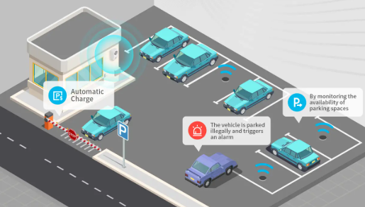
Example:
A | B | C | D | Status
0 | 0 | 0 | 0 | All vacant
1 | 0 | 0 | 0 | One occupied
1 | 1 | 1 | 0 | One slot available
1 | 1 | 1 | 1 | Parking Full
Logic Gates Used :
Main Logic Gates
NOT Gate
Detects whether a slot is vacant.
OR Gate
Determines whether at least one slot is available.
AND Gate
Controls vehicle entry.
Parking Available:
P=A+B+C+D

Slide 6

Block Diagram :
Slot A ──> NOT ──┐
Slot B ──> NOT ──┤
Slot C ──> NOT ──┤──> OR ──> Parking Available
Slot D ──> NOT ──┘
│
▼
Vehicle Present ─────> AND ──> Entry Allowed
Outputs :
Parking Available
Entry Allowed
Parking Full

Slide 7
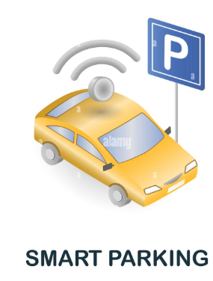
Truth Table :
For a simple 2-slot example:
Slot A | Slot B | Parking Available | Parking Full
0 | 0 | 1 | 0
0 | 1 | 1 | 0
1 | 0 | 1 | 0
1 | 1 | 0 | 1
Meaning:
0 = Vacant
1 = Occupied
  Entry Control & Working
  Entry Equation :
  Let:
  V = Vehicle present
  P = Parking available
  Then:
  E=V⋅P

Slide 8
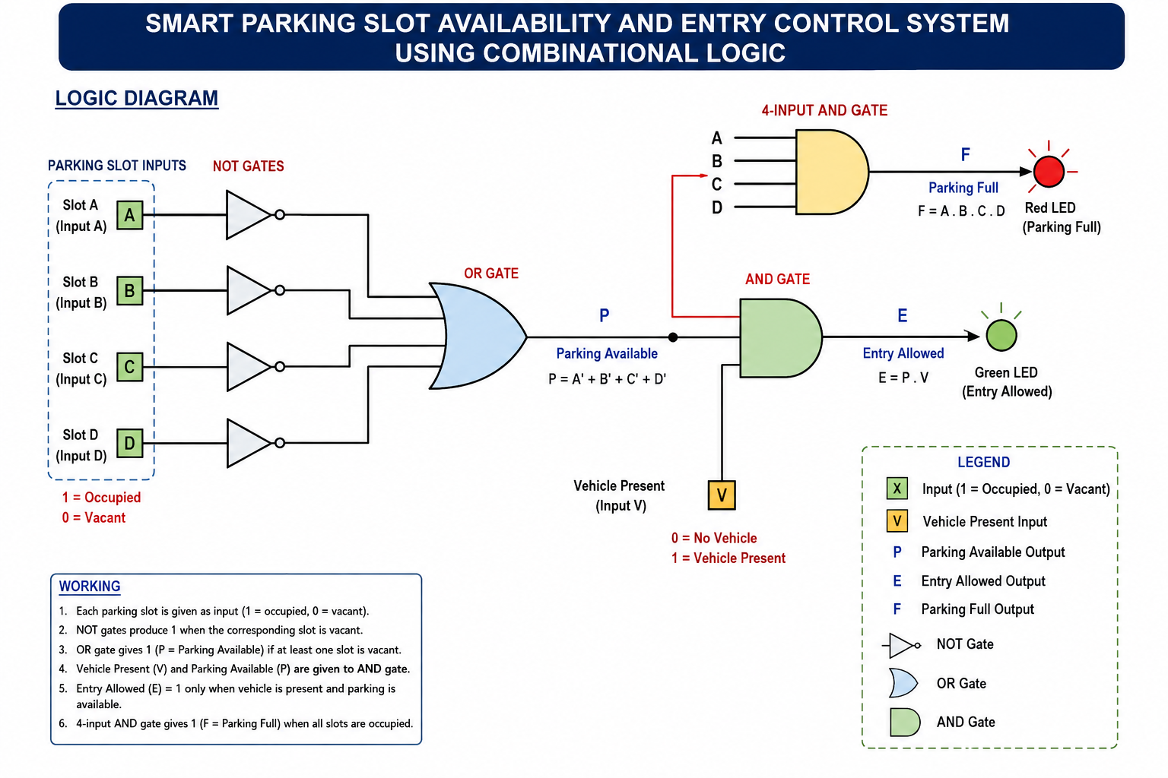

Slide 9
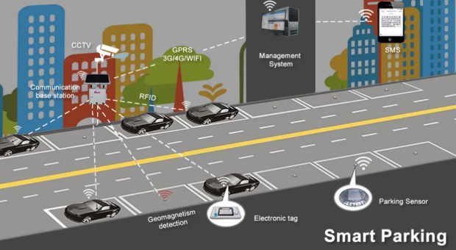
Logisim Simulation:
Create input switches.
Add NOT gates.
Connect them to an OR gate.
Add an AND gate for entry control.
Connect LEDs to the outputs.
Test different input combinations.
Advantages:
Simple and low-cost design
Reduces manual effort
Quick parking-status detection
Prevents entry when parking is full
Easy to simulate and understand
Applications :
    Shopping malls
    Colleges
    Hospitals
    Airports
    Offices
    Hotels

Slide 10

Thank You

